Slide 1



Medi-Locator
Team names

Slide 2


Project Objectives
MediLocator is not just a healthcare app, it is a life saving app. With your support, we can equip every hospital with it and save many lives
A healthcare app designed to assist patients in hospitals by improving access to medical care
It helps patients get quicker assistance at the reception, schedule necessary scans and receive early diagnoses.

Slide 3

The Problems to Solve
It enables doctors to do home visits for patients who are unable to visit the hospital
01
02
Easy to locate departments, labs or supervisors.
03
Interactive, Gps-style, indoor maps and personalised for each hospital layout.

Slide 4

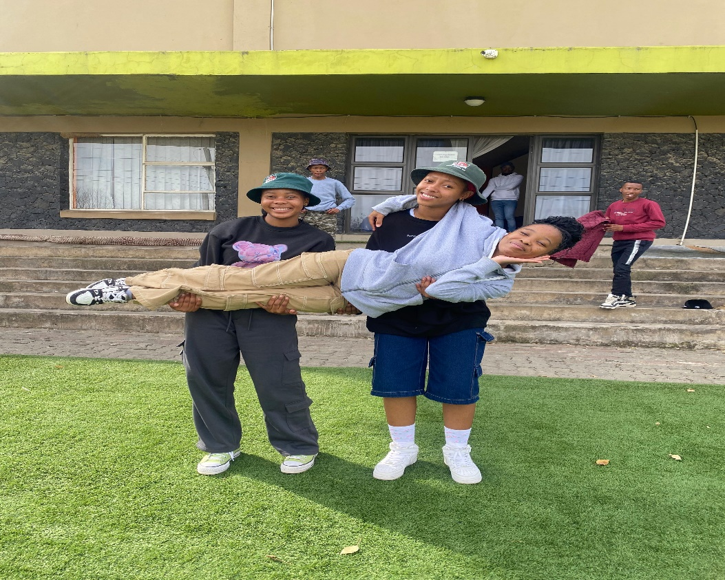

Offered Solutions
01.
02.
03.
Innovation
Collabrative Team
Growth Potential

Slide 5



Next Steps
Presenter Challenges
Lack of time management, countless errors, laptop errors, slides not working and videos and photos not loading

Slide 6

Thank You.

